Slide 1
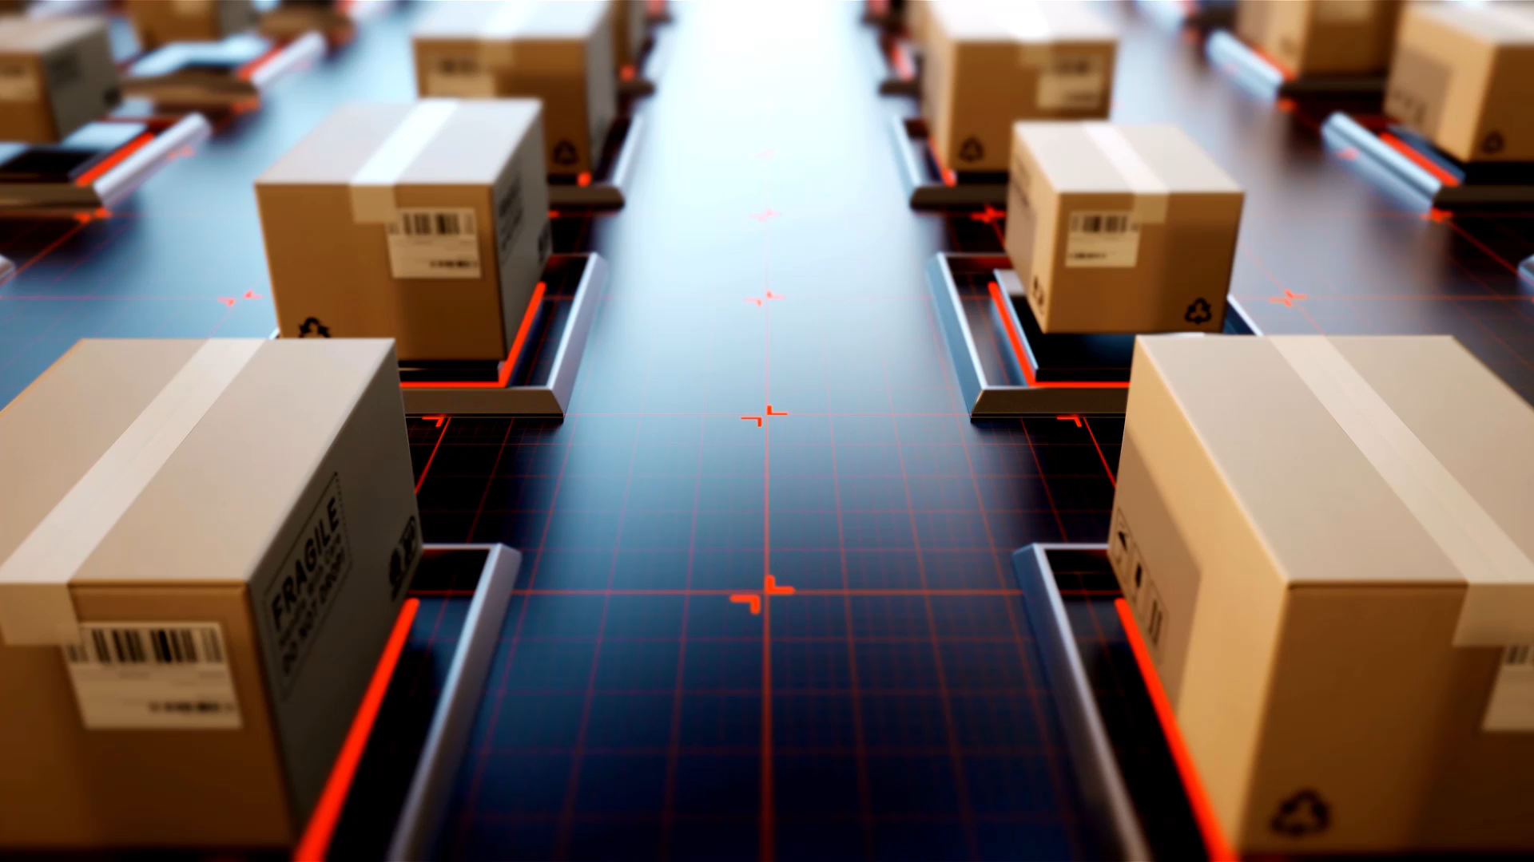
Operating Systems Project
Android app to control and gather data from a water borne self propelled automated
probe.

Slide 2
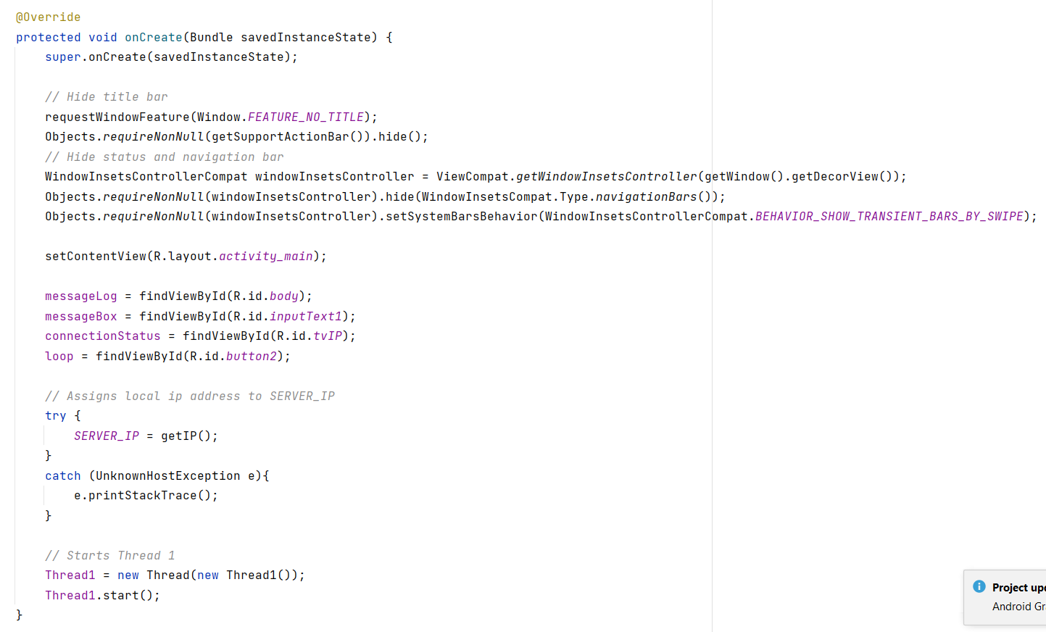
Initiating the app

Slide 3
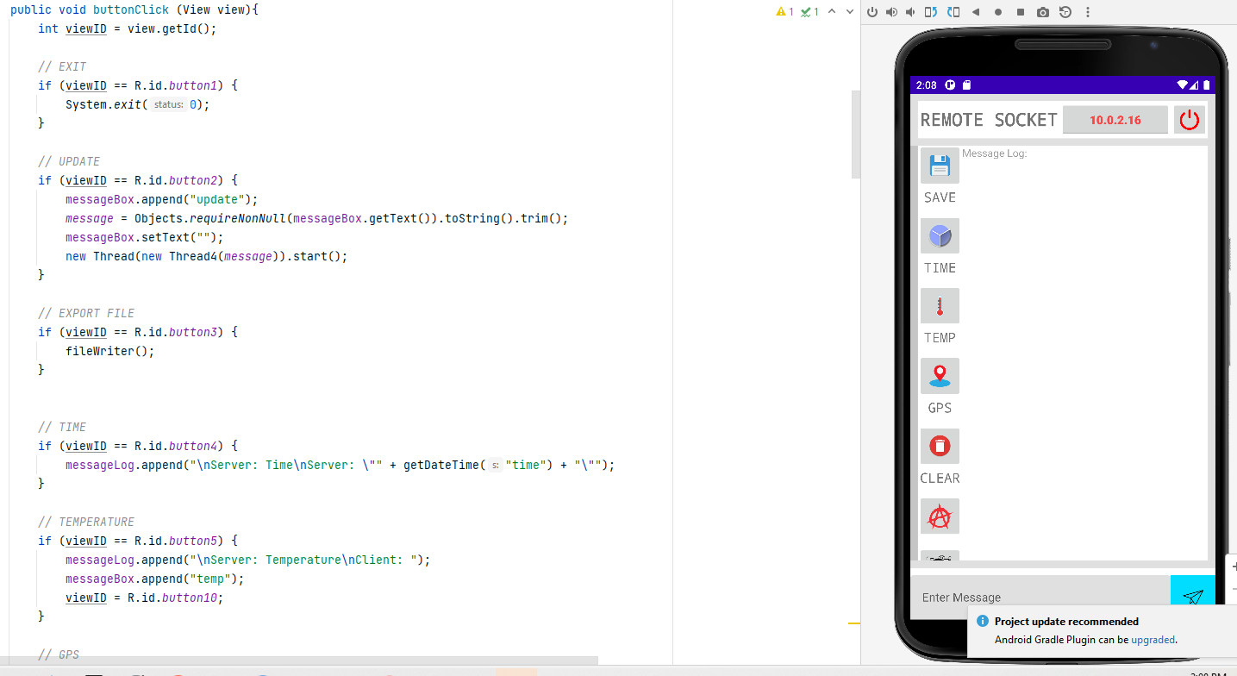
This is where the button magic happens

Slide 4
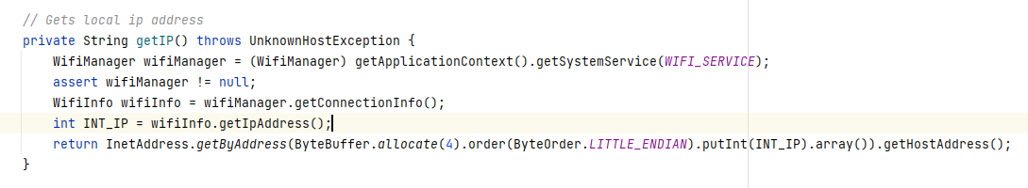
Here we are setting up the environment to get an IP address. This is used to provide the probe with an address to call. Any WIFI can be used given that the ID is known to the probe as well as the Password. Then the IP and port are declared to be listening on the app and the probe. We did not have to use an internet connection because the probe has its own LAN.

Slide 5
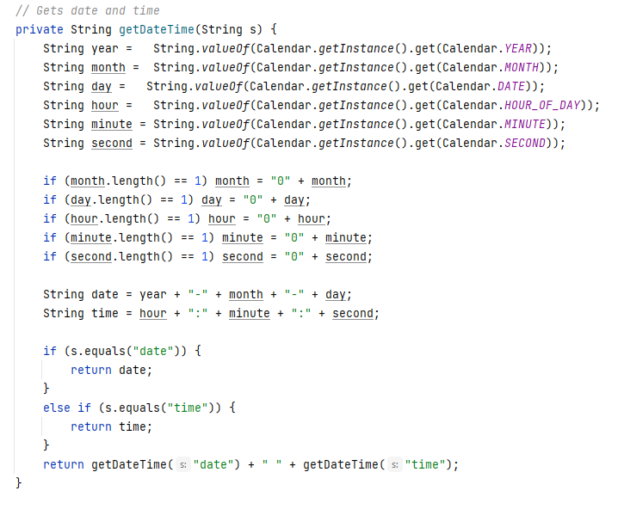
Here is a solution to getting the data which is very important to our data strictly from the device’s time

Slide 6
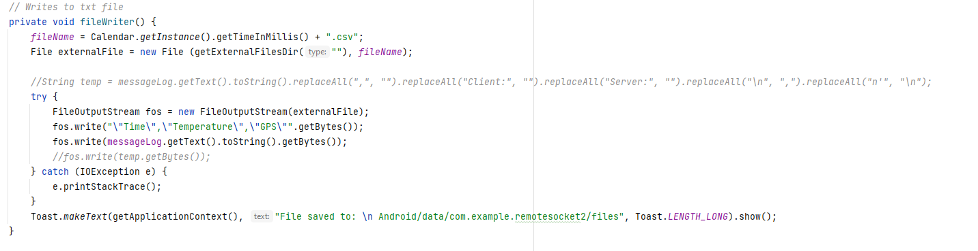
Here we are taking our data and saving it to a comma separated file

Slide 7
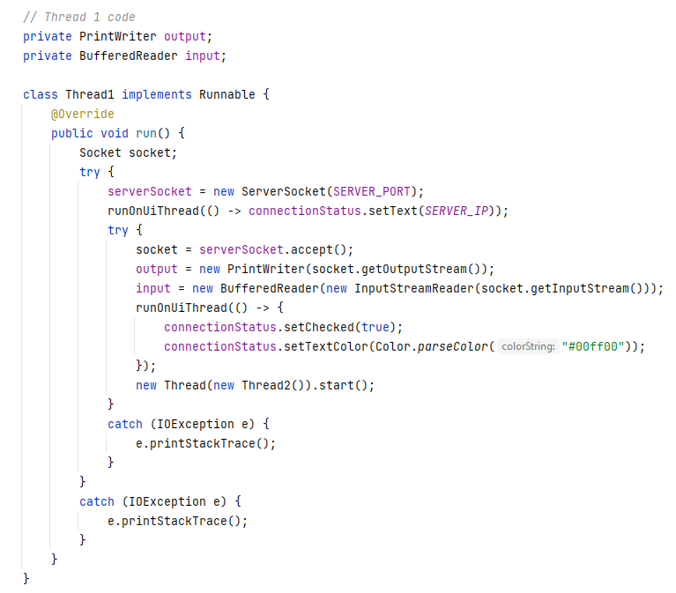
This thread is very important to us here we start our process of communicating with the remote device

Slide 8
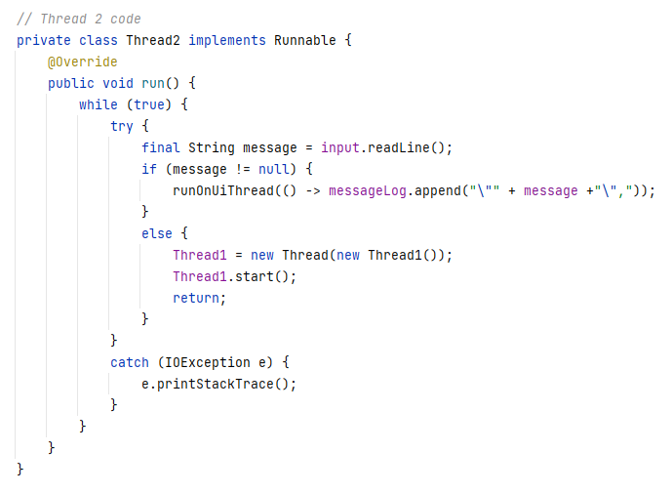
This thread2 is initialized by thread and loops back to it if no message is retrieved. A true thread in the literal sense. They go back and forward to make sure messages get sent and received

Slide 9
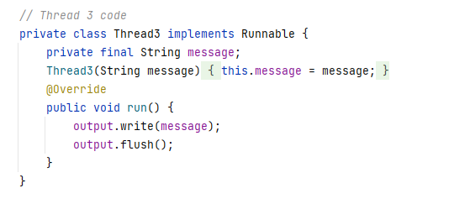
This thread3 is a very smart solution given by Zed it may not look like much, but it saves a lot of coding, I think of it as a sort of reverse code factory design. If you go back to the buttons, they all use it, and it is only instantiated once

Slide 10
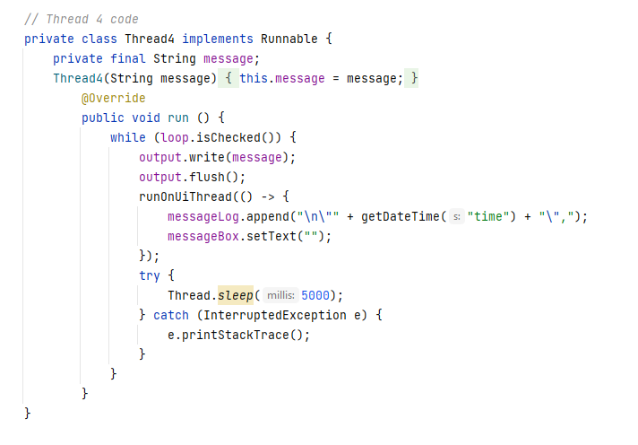
This thread4 is also used by a button it updates the information in a useful visual log in a table format

Slide 11
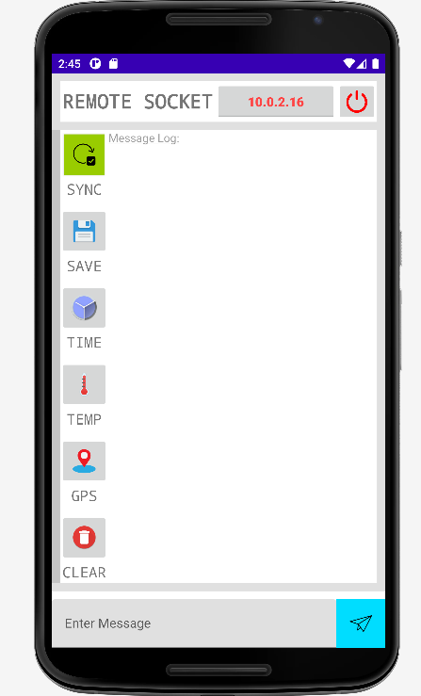
This is our application; it is hard to explain all the cool things it does, but we will demonstrate them with the help of the probe it is meant to operate.

Slide 12
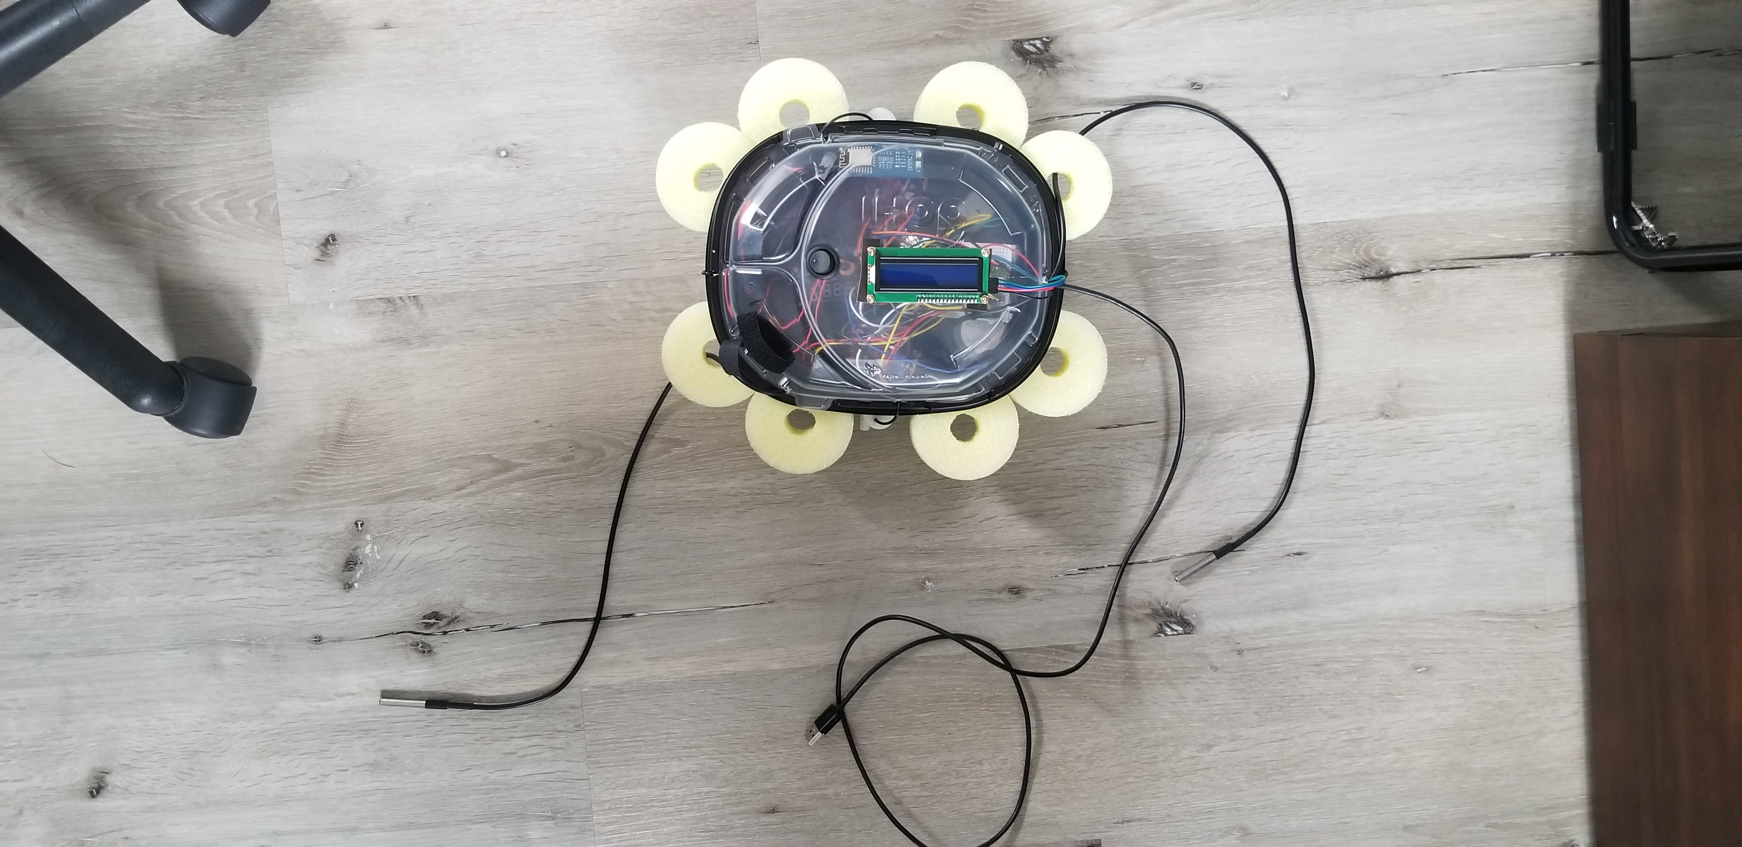
This is our device it has grown since conception. It currently carries a pi Pico microcontroller; a buck down dc converter; 2 motor controllers with capacity for 2 motors each; a WIFI module; a GPS module; two water thermometer sensors; a lcd screen; and 4 little fish tank pumps

Slide 13
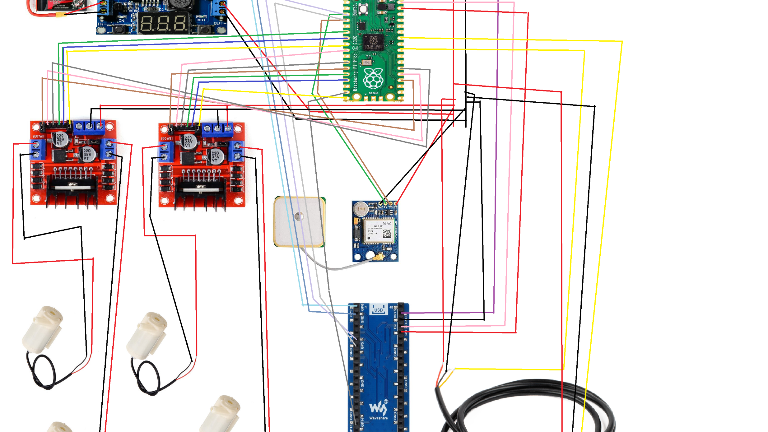
Our probe has grown so much this diagram is actually missing some parts and need to be updated. But enough with the boring. Let's see it work!!!

